Slide 1
Section 2.3
Lines
Copyright © 2012 Pearson Education, Inc. Publishing as Prentice Hall.

Slide 2
Copyright © 2012 Pearson Education, Inc. Publishing as Prentice Hall.

Slide 3
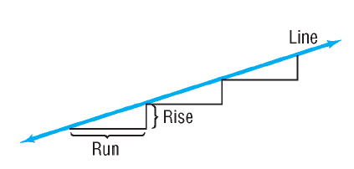
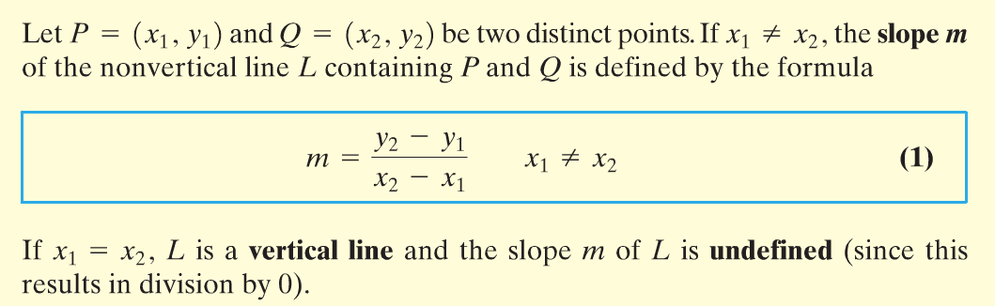
Copyright © 2012 Pearson Education, Inc. Publishing as Prentice Hall.

Slide 4
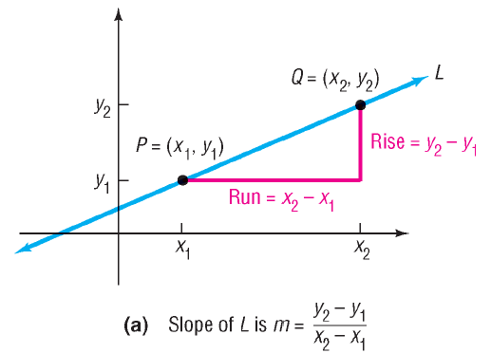
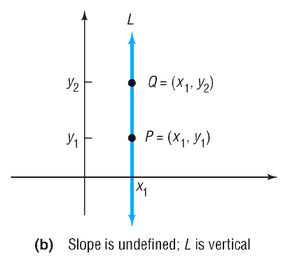


Copyright © 2012 Pearson Education, Inc. Publishing as Prentice Hall.

Slide 5
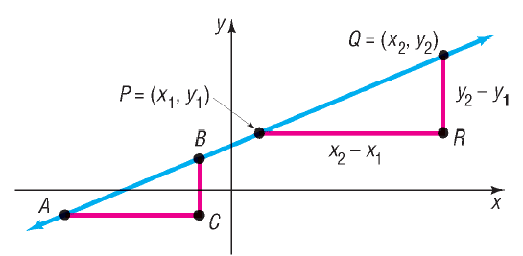
Copyright © 2012 Pearson Education, Inc. Publishing as Prentice Hall.

Slide 6


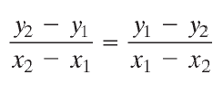
Copyright © 2012 Pearson Education, Inc. Publishing as Prentice Hall.

Slide 7

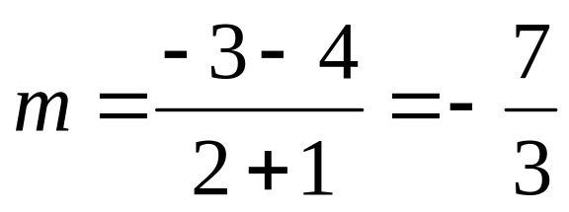
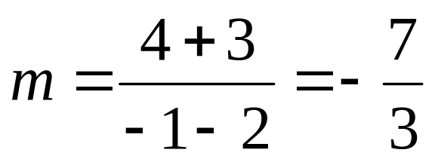
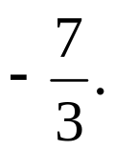
Find the slope of the line containing the points (-1, 4) and (2, -3).
The average rate of change of y with respect to x is
Copyright © 2012 Pearson Education, Inc. Publishing as Prentice Hall.

Slide 8
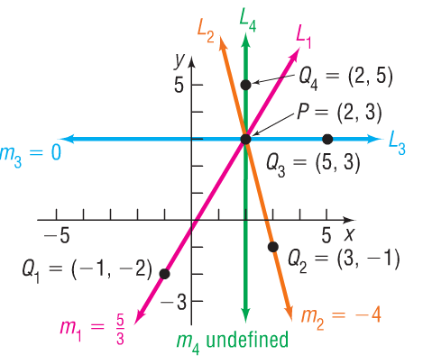
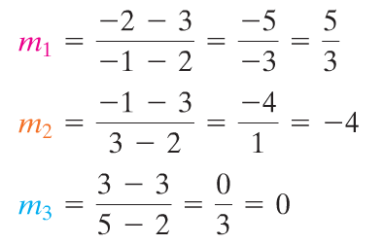
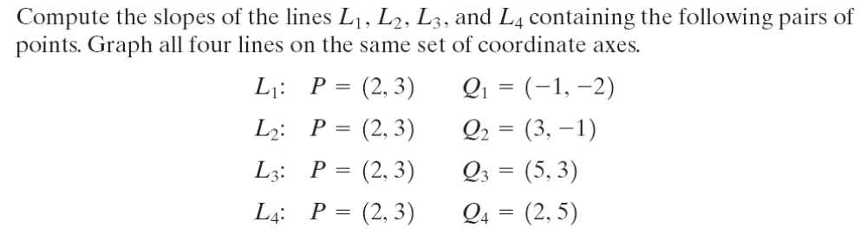

Compute the slopes of the lines L₁, L₂, L₃, and L₄ containing the following pairs of points. Graph all four lines on the same set of coordinate axes.
Copyright © 2012 Pearson Education, Inc. Publishing as Prentice Hall.

Slide 9
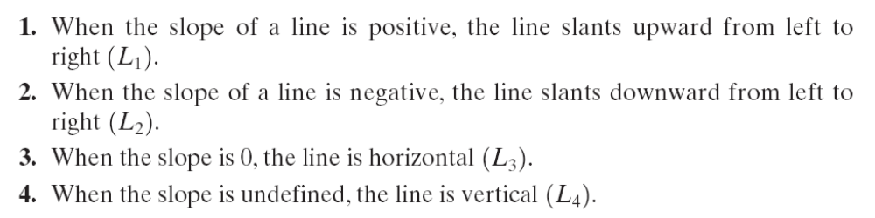
Copyright © 2012 Pearson Education, Inc. Publishing as Prentice Hall.

Slide 10

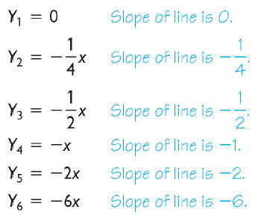
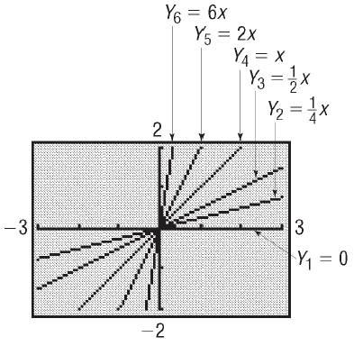
Copyright © 2012 Pearson Education, Inc. Publishing as Prentice Hall.

Slide 11
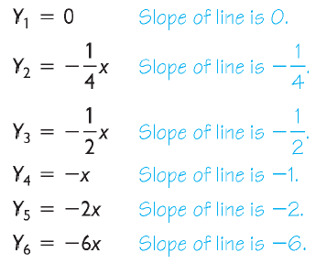
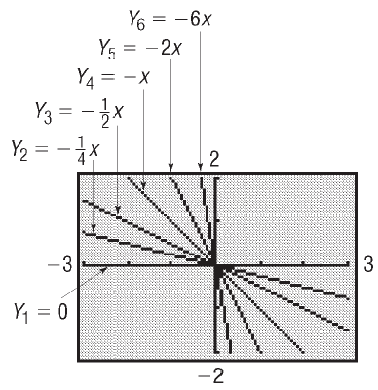
Copyright © 2012 Pearson Education, Inc. Publishing as Prentice Hall.

Slide 12

Copyright © 2012 Pearson Education, Inc. Publishing as Prentice Hall.

Slide 13


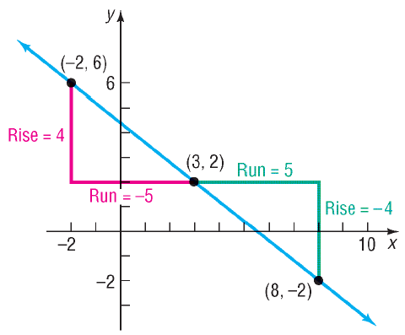
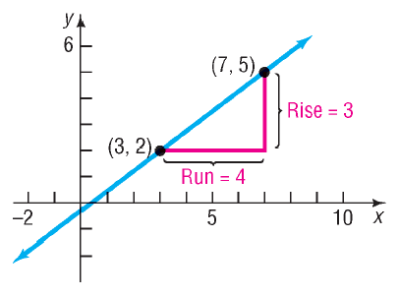
Copyright © 2012 Pearson Education, Inc. Publishing as Prentice Hall.

Slide 14
Copyright © 2012 Pearson Education, Inc. Publishing as Prentice Hall.

Slide 15

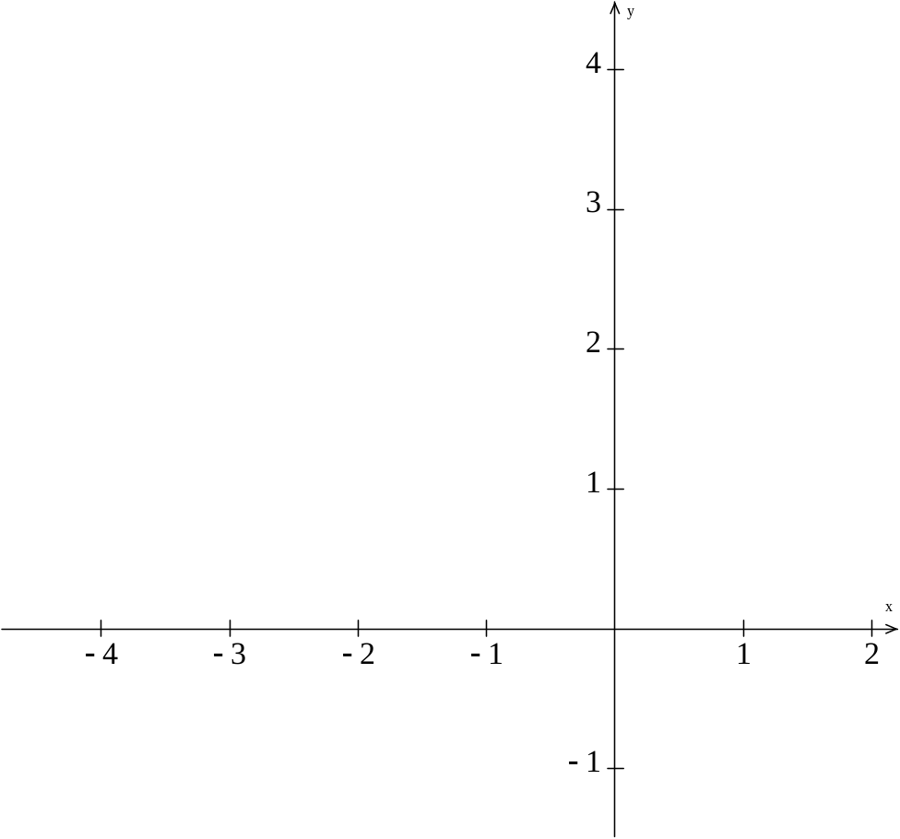
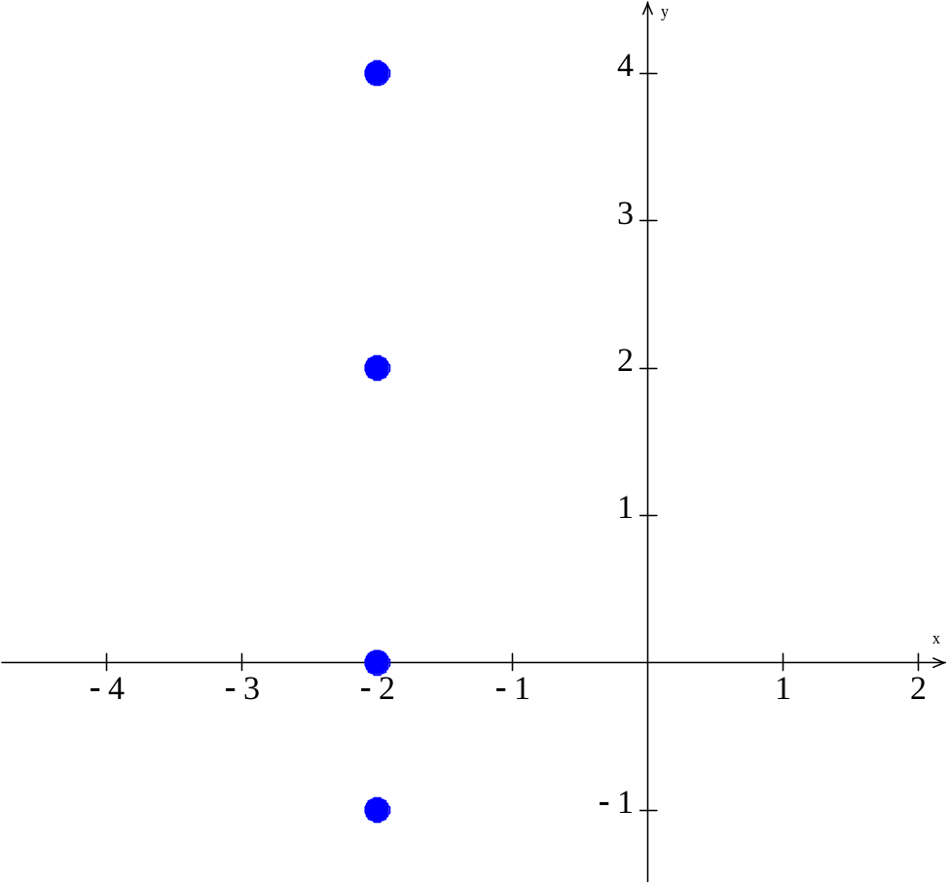
Graph the equation: x = –2
(-2,4)
(-2,2)
(-2,0)
(-2,1)
Copyright © 2012 Pearson Education, Inc. Publishing as Prentice Hall.

Slide 16

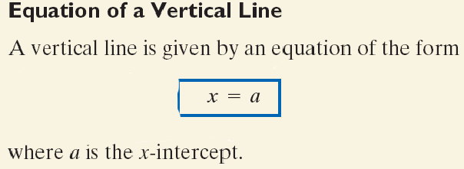
Copyright © 2012 Pearson Education, Inc. Publishing as Prentice Hall.

Slide 17
Copyright © 2012 Pearson Education, Inc. Publishing as Prentice Hall.

Slide 18
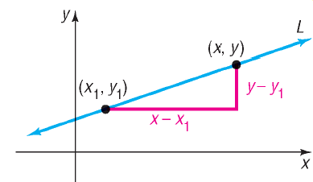

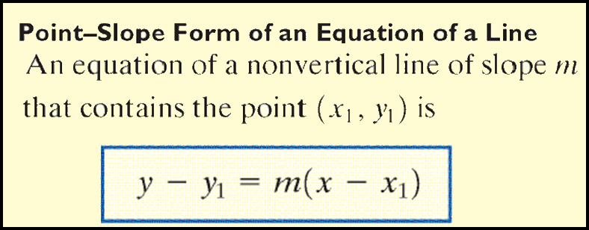
Copyright © 2012 Pearson Education, Inc. Publishing as Prentice Hall.

Slide 19

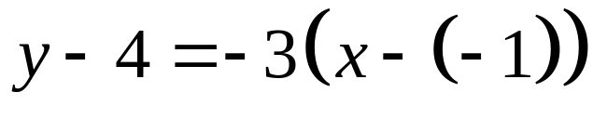
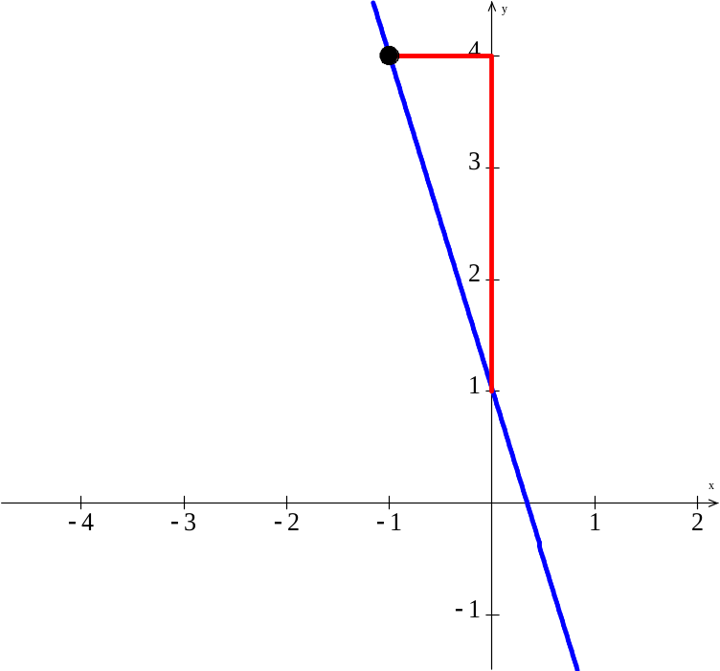
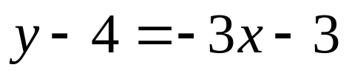
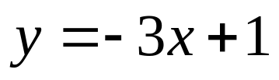
Find the equation of a line with slope –3 and containing the point (–1, 4).
Run = 1
Rise = -3
Copyright © 2012 Pearson Education, Inc. Publishing as Prentice Hall.

Slide 20
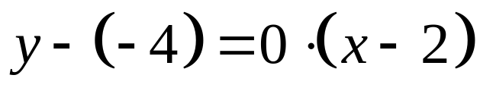
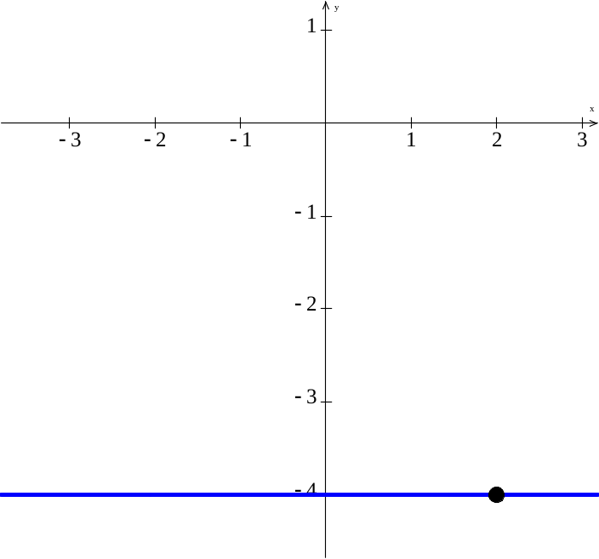
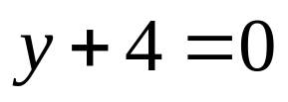
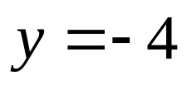
Find the equation of a horizontal line containing the point (2, – 4).
Copyright © 2012 Pearson Education, Inc. Publishing as Prentice Hall.

Slide 21
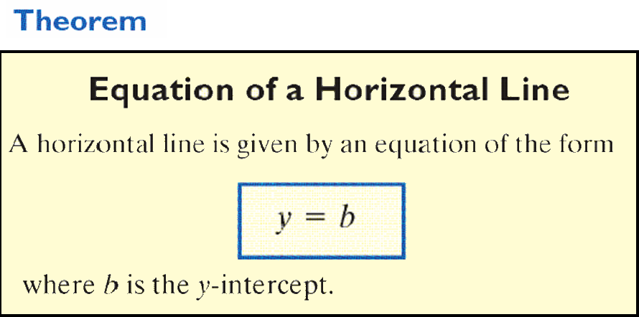
Copyright © 2012 Pearson Education, Inc. Publishing as Prentice Hall.

Slide 22
Copyright © 2012 Pearson Education, Inc. Publishing as Prentice Hall.

Slide 23
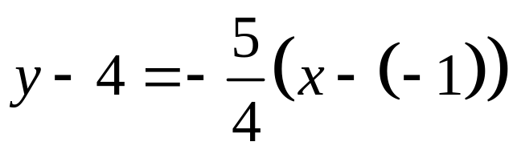
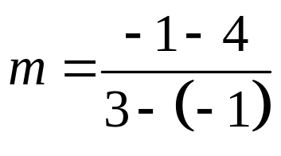
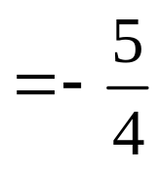
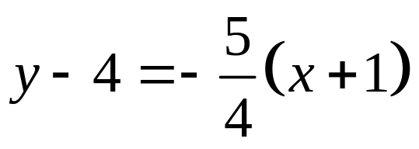
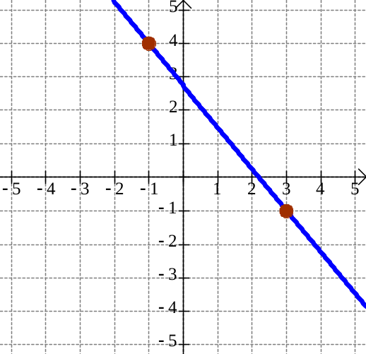
Find an equation of the line L containing the points (–1, 4) and (3, –1). Graph the line L.
(-1, 4)
(3, -1)
Copyright © 2012 Pearson Education, Inc. Publishing as Prentice Hall.

Slide 24
Copyright © 2012 Pearson Education, Inc. Publishing as Prentice Hall.

Slide 25

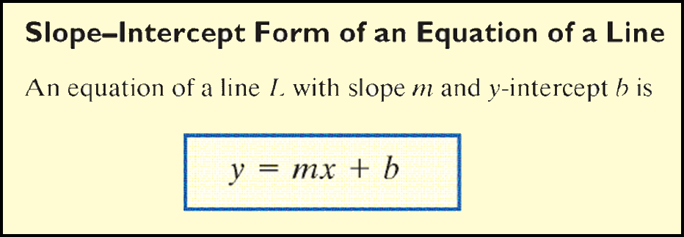
Copyright © 2012 Pearson Education, Inc. Publishing as Prentice Hall.

Slide 26

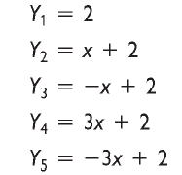
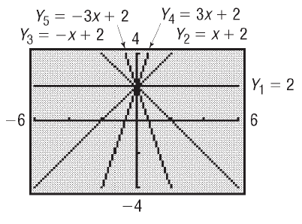
Graph the following lines on the same square screen
Copyright © 2012 Pearson Education, Inc. Publishing as Prentice Hall.

Slide 27
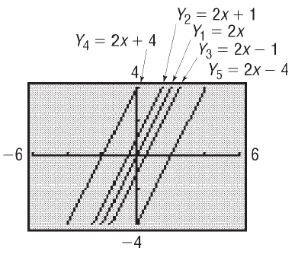
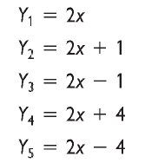
Graph the following lines on the same square screen
Copyright © 2012 Pearson Education, Inc. Publishing as Prentice Hall.

Slide 28
Copyright © 2012 Pearson Education, Inc. Publishing as Prentice Hall.

Slide 29

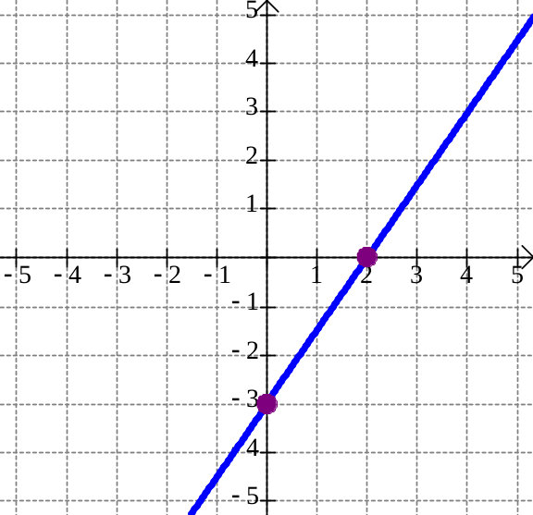
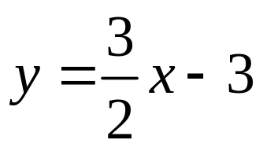

Find the slope m and y-intercept b of the equation
3x – 2y = 6. Graph the equation.
3x – 2y = 6
– 2y = –3x + 6
2
(2, 0)
3
(0, -3)
Copyright © 2012 Pearson Education, Inc. Publishing as Prentice Hall.

Slide 30
Copyright © 2012 Pearson Education, Inc. Publishing as Prentice Hall.

Slide 31
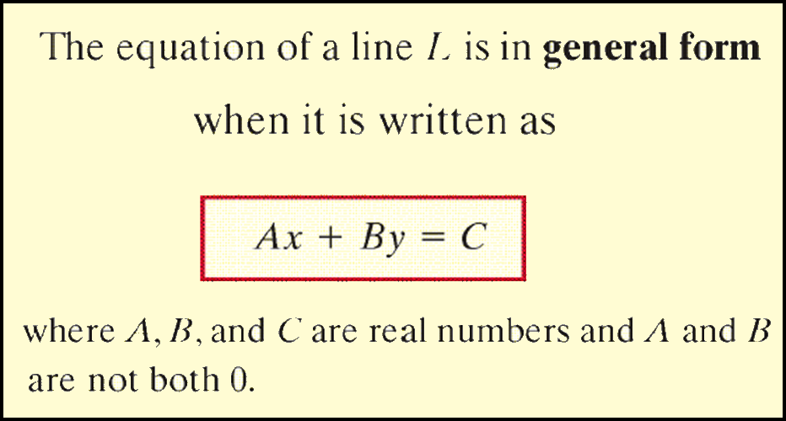
Copyright © 2012 Pearson Education, Inc. Publishing as Prentice Hall.

Slide 32
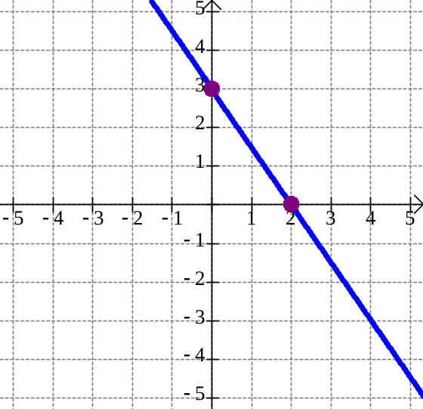
Graph the linear equation 3x + 2y = 6 by finding its intercepts.
3x + 2(0) = 6
3(0) + 2y = 6
3x = 6
2y = 6
x = 2
y = 3
(0, 3)
The x-intercept is at the point (2, 0).
(2, 0)
The y-intercept is at the point (0, 3).
Copyright © 2012 Pearson Education, Inc. Publishing as Prentice Hall.

Slide 33

Copyright © 2012 Pearson Education, Inc. Publishing as Prentice Hall.

Slide 34
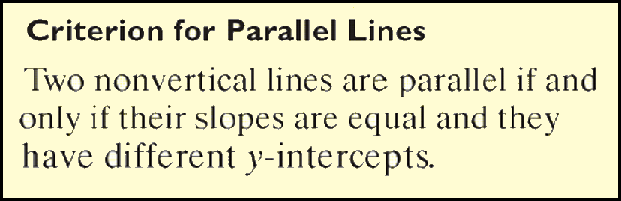
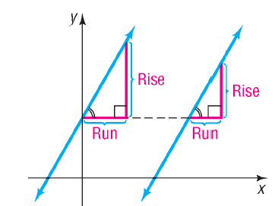
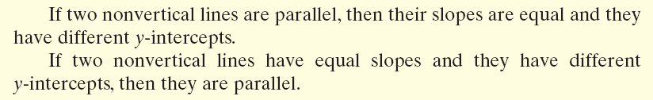
Copyright © 2012 Pearson Education, Inc. Publishing as Prentice Hall.

Slide 35










Copyright © 2012 Pearson Education, Inc. Publishing as Prentice Hall.

Slide 36








Copyright © 2012 Pearson Education, Inc. Publishing as Prentice Hall.

Slide 37
Copyright © 2012 Pearson Education, Inc. Publishing as Prentice Hall.

Slide 38



Copyright © 2012 Pearson Education, Inc. Publishing as Prentice Hall.

Slide 39

Copyright © 2012 Pearson Education, Inc. Publishing as Prentice Hall.

Slide 40





Find the slope of a line perpendicular to a line with slope .
Copyright © 2012 Pearson Education, Inc. Publishing as Prentice Hall.

Slide 41





Copyright © 2012 Pearson Education, Inc. Publishing as Prentice Hall.

